Slide 1

CHAPTER 9
Testing of Hypothesis
DISCOVER . LEARN . EMPOWER

Slide 2
INDEX
Z- test
F-test

Slide 3
Z- test
Z-test is a statistical test that is used to determine whether the mean of a sample is significantly different from a known population mean when the population standard deviation is known.
It is particularly useful when the sample size is large (>30).
Z-test can also be defined as a statistical method that is used to determine whether the distribution of the test statistics can be approximated using the normal distribution or not.
It is the method to determine whether two sample means are approximately the same or different when their variance is known and the sample size is large (should be >= 30).

Slide 4
Steps to perform Z-test:
First, identify the null and alternate hypotheses.
Determine the level of significance (∝).
Find the critical value of z in the z-test using
Calculate the z-test statistics. Below is the formula for calculating the z-test statistics.
where,
X: mean of the sample.
ᴜ: mean of the population.
σ: Standard deviation of the population.
√n: sample size.

Slide 5
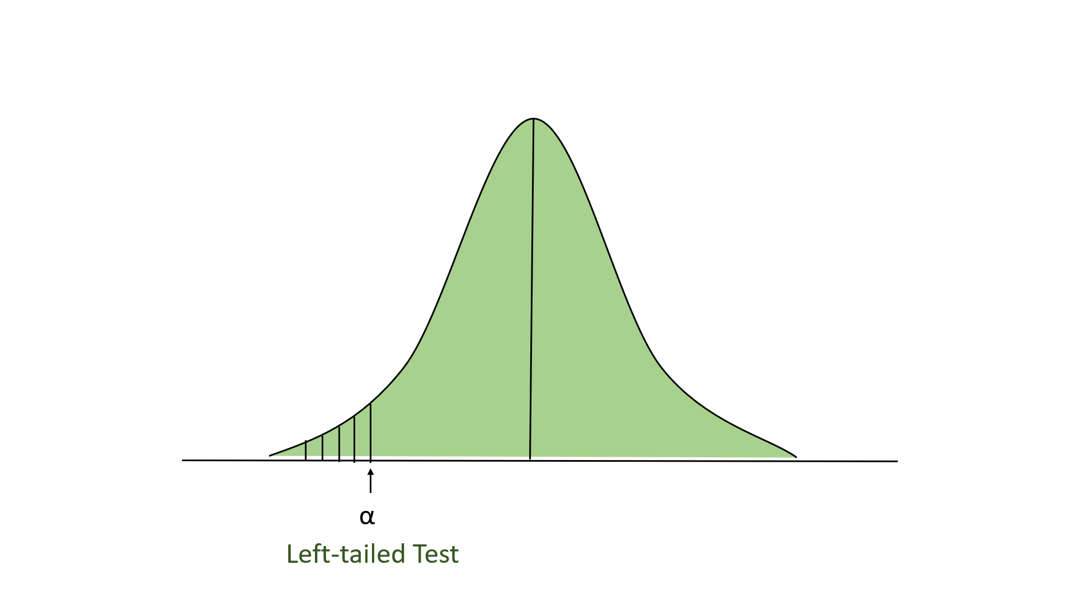
Type of Z-test
Left-tailed Test: In this test, our region of rejection is located to the extreme left of the distribution. Here our null hypothesis is that the claimed value is less than or equal to the mean population value.

Slide 6
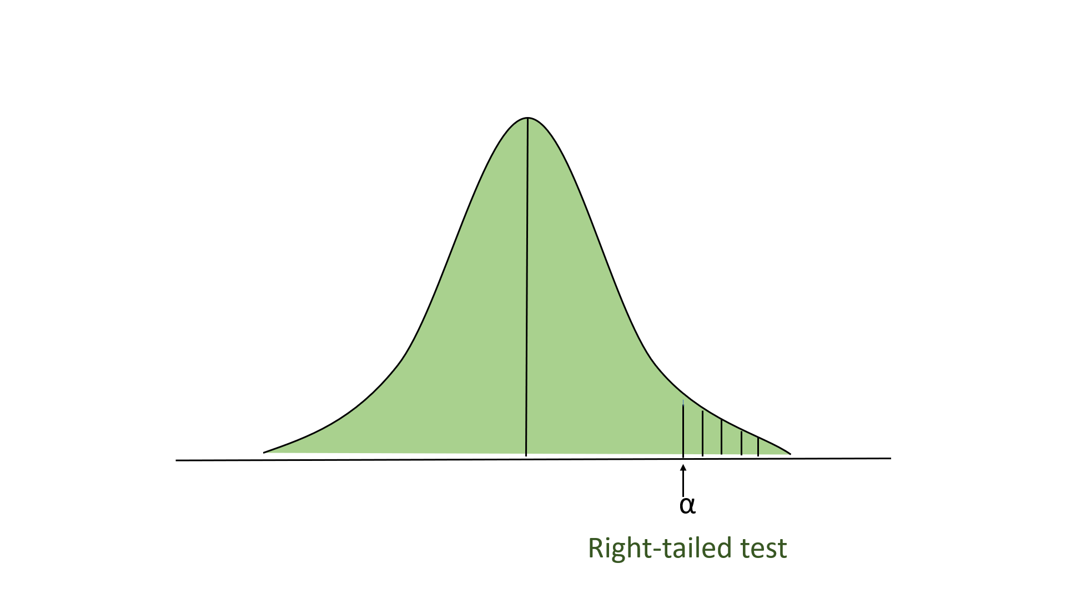
Right-tailed Test
In this test, our region of rejection is located to the extreme right of the distribution. Here our null hypothesis is that the claimed value is less than or equal to the mean population value.

Slide 7
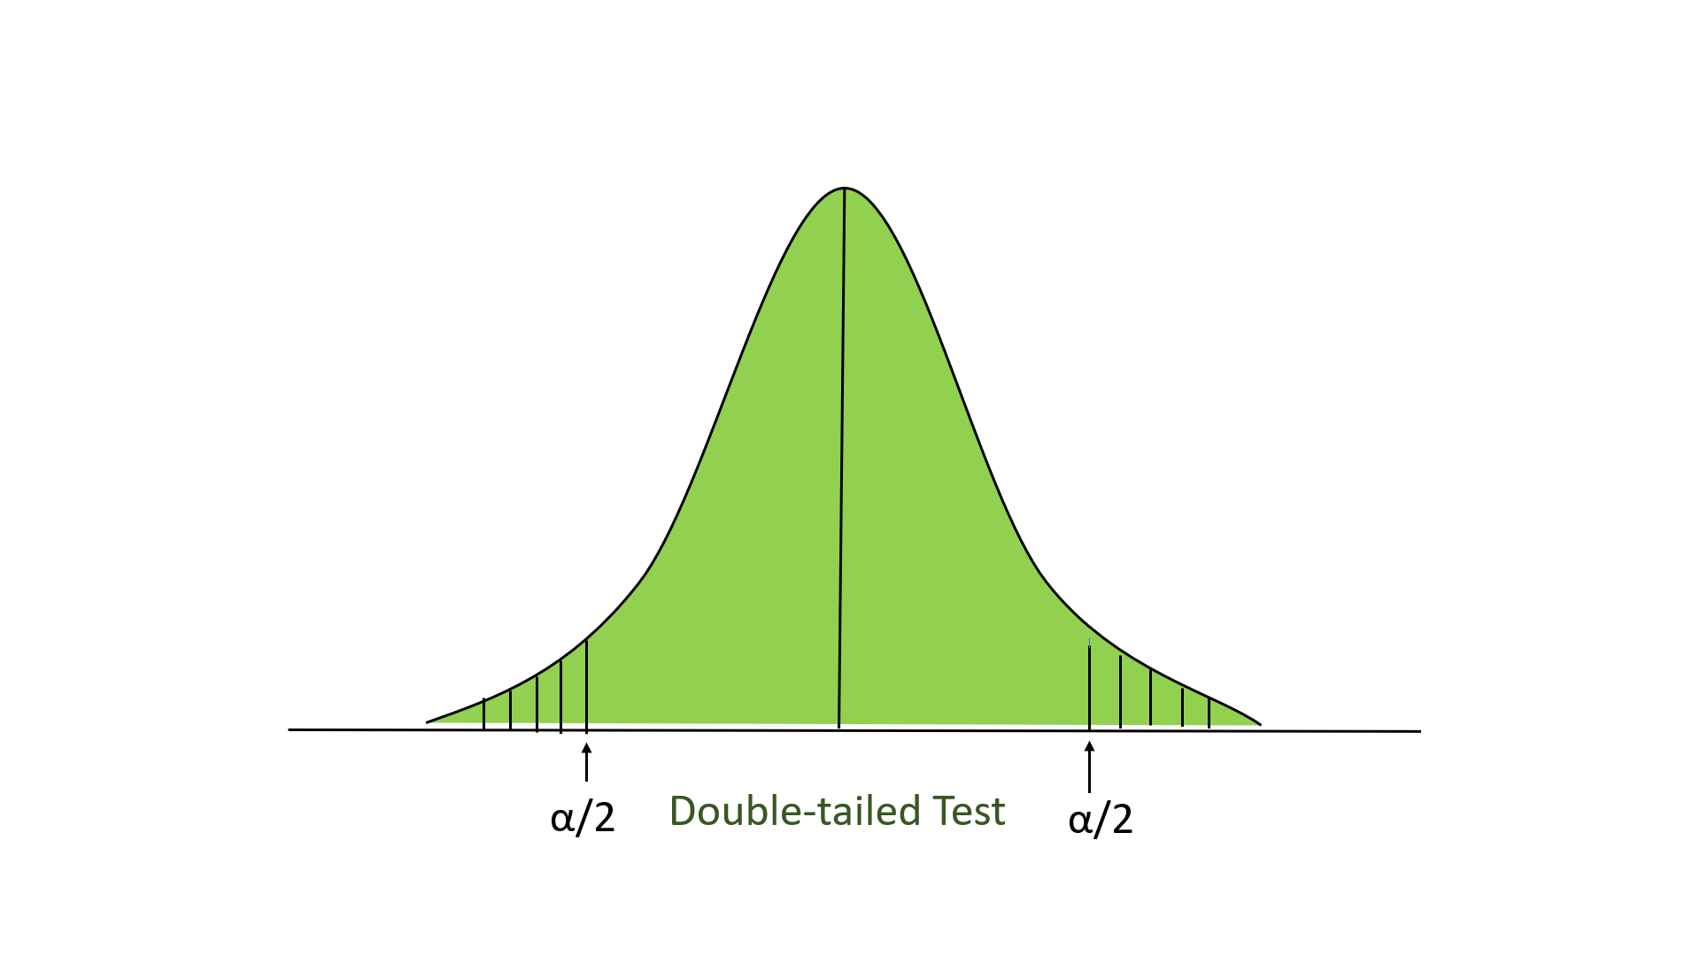
Two-tailed test
In this test, our region of rejection is located to both extremes of the distribution. Here our null hypothesis is that the claimed value is equal to the mean population value.

Slide 8

F-Test
F-Test is any test that utilizes the F-Distribution table to fulfill its purpose (for eg: ANOVA).
It compares the ratio of the variances of two populations and determines if they are statistically similar or not.
We can use this test when :
The population is normally distributed.
The samples are taken at random and are independent samples.
Formulas Used
where, F_{calc} = Critical F-value. σ₁² & σ₂² = variance of the two samples. where, df = Degrees of freedom of the sample. n_{S} = Sample size.

